Slide 1

Application of Machine Learning in predicting protein sequences
Gehan Ranepura
Course: PHYS85200 – Machine Learning for Scientists
Professor: Dr. Viviana Acquaviva

Slide 2
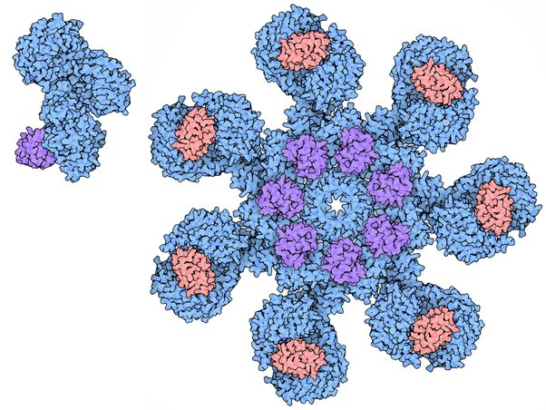
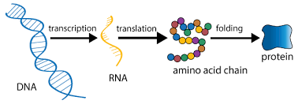
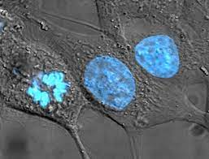
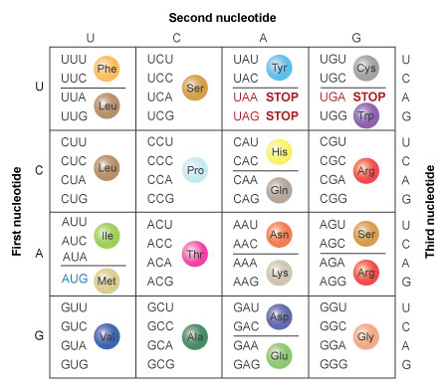
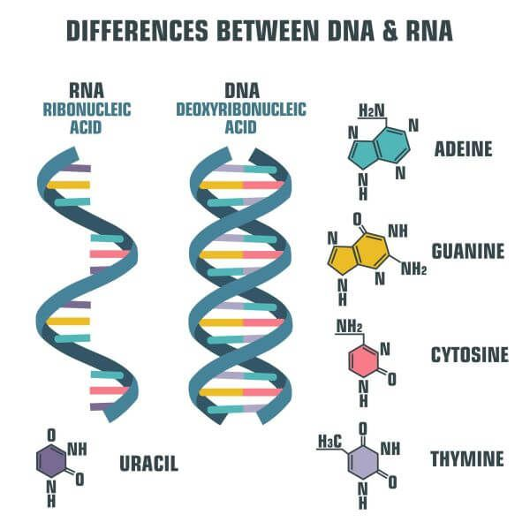
Central Dogma of Molecular Biology
Apotosome
“The Death Protein”

Slide 3
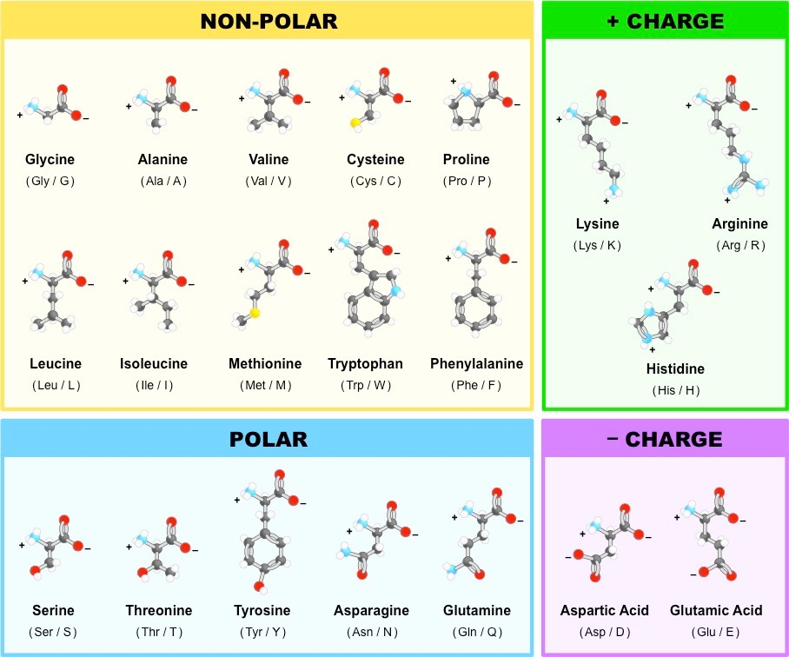
Central Dogma of Molecular Biology
Apotosome
“The Death Protein”

Slide 4
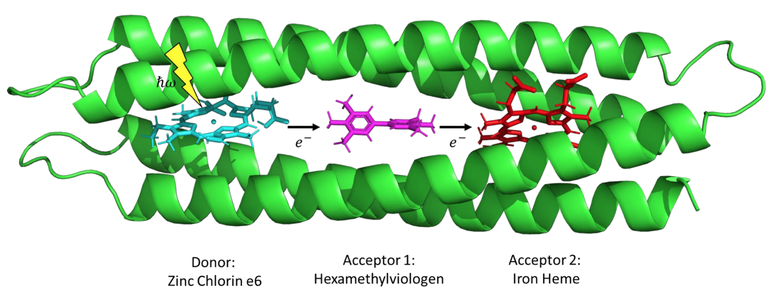
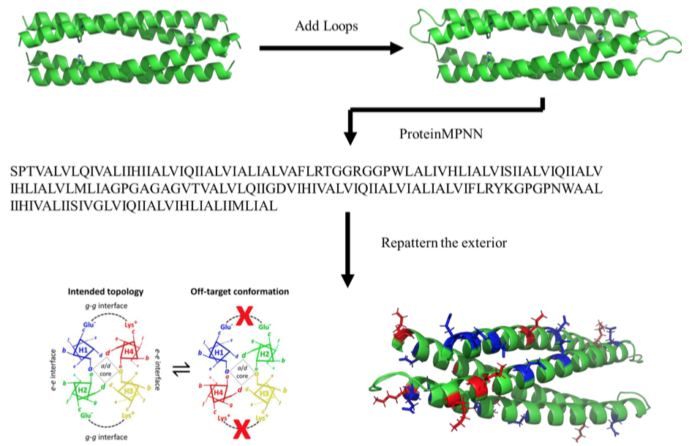
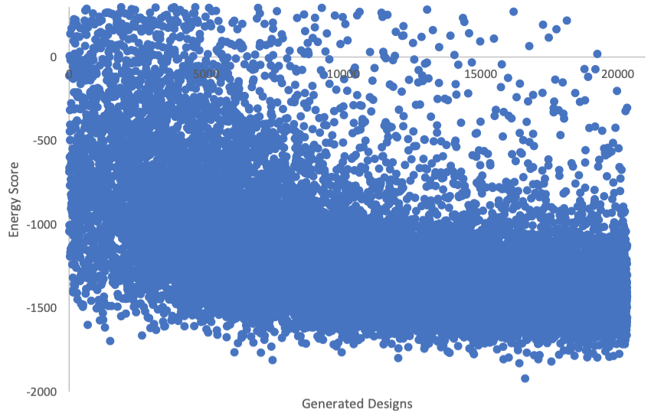
Simulated Folding Energies of four-helix bundle protein with cofactors

Slide 5
Simulated Folding Energies of four-helix bundle protein with cofactors
175 Residue Sequence
SFEEAIQEAQQTGQKAQQAGQEFAQAGQAAQQTGQKVQQAGGSGGFQQGFQEHRQAGQAIQQTFQEDQQAFQEHRQAGQKFQKYGGGSGGSLEKAIQEAQQTVQEVQQAIQEERQAFQAVQQTAQEFQQAGGSGGAQQAVQKARQAGQAGQQTAQKAQQAVQKHRQAFQEVQKYG
Only positions 16,20,23,24,27,60,64,71,103,106,110,117,150,154,157, and 161
will be different between each sequence.
The mutable positions can only be G,A,V,L,I,F → 16*6 = 96 features!

Slide 6
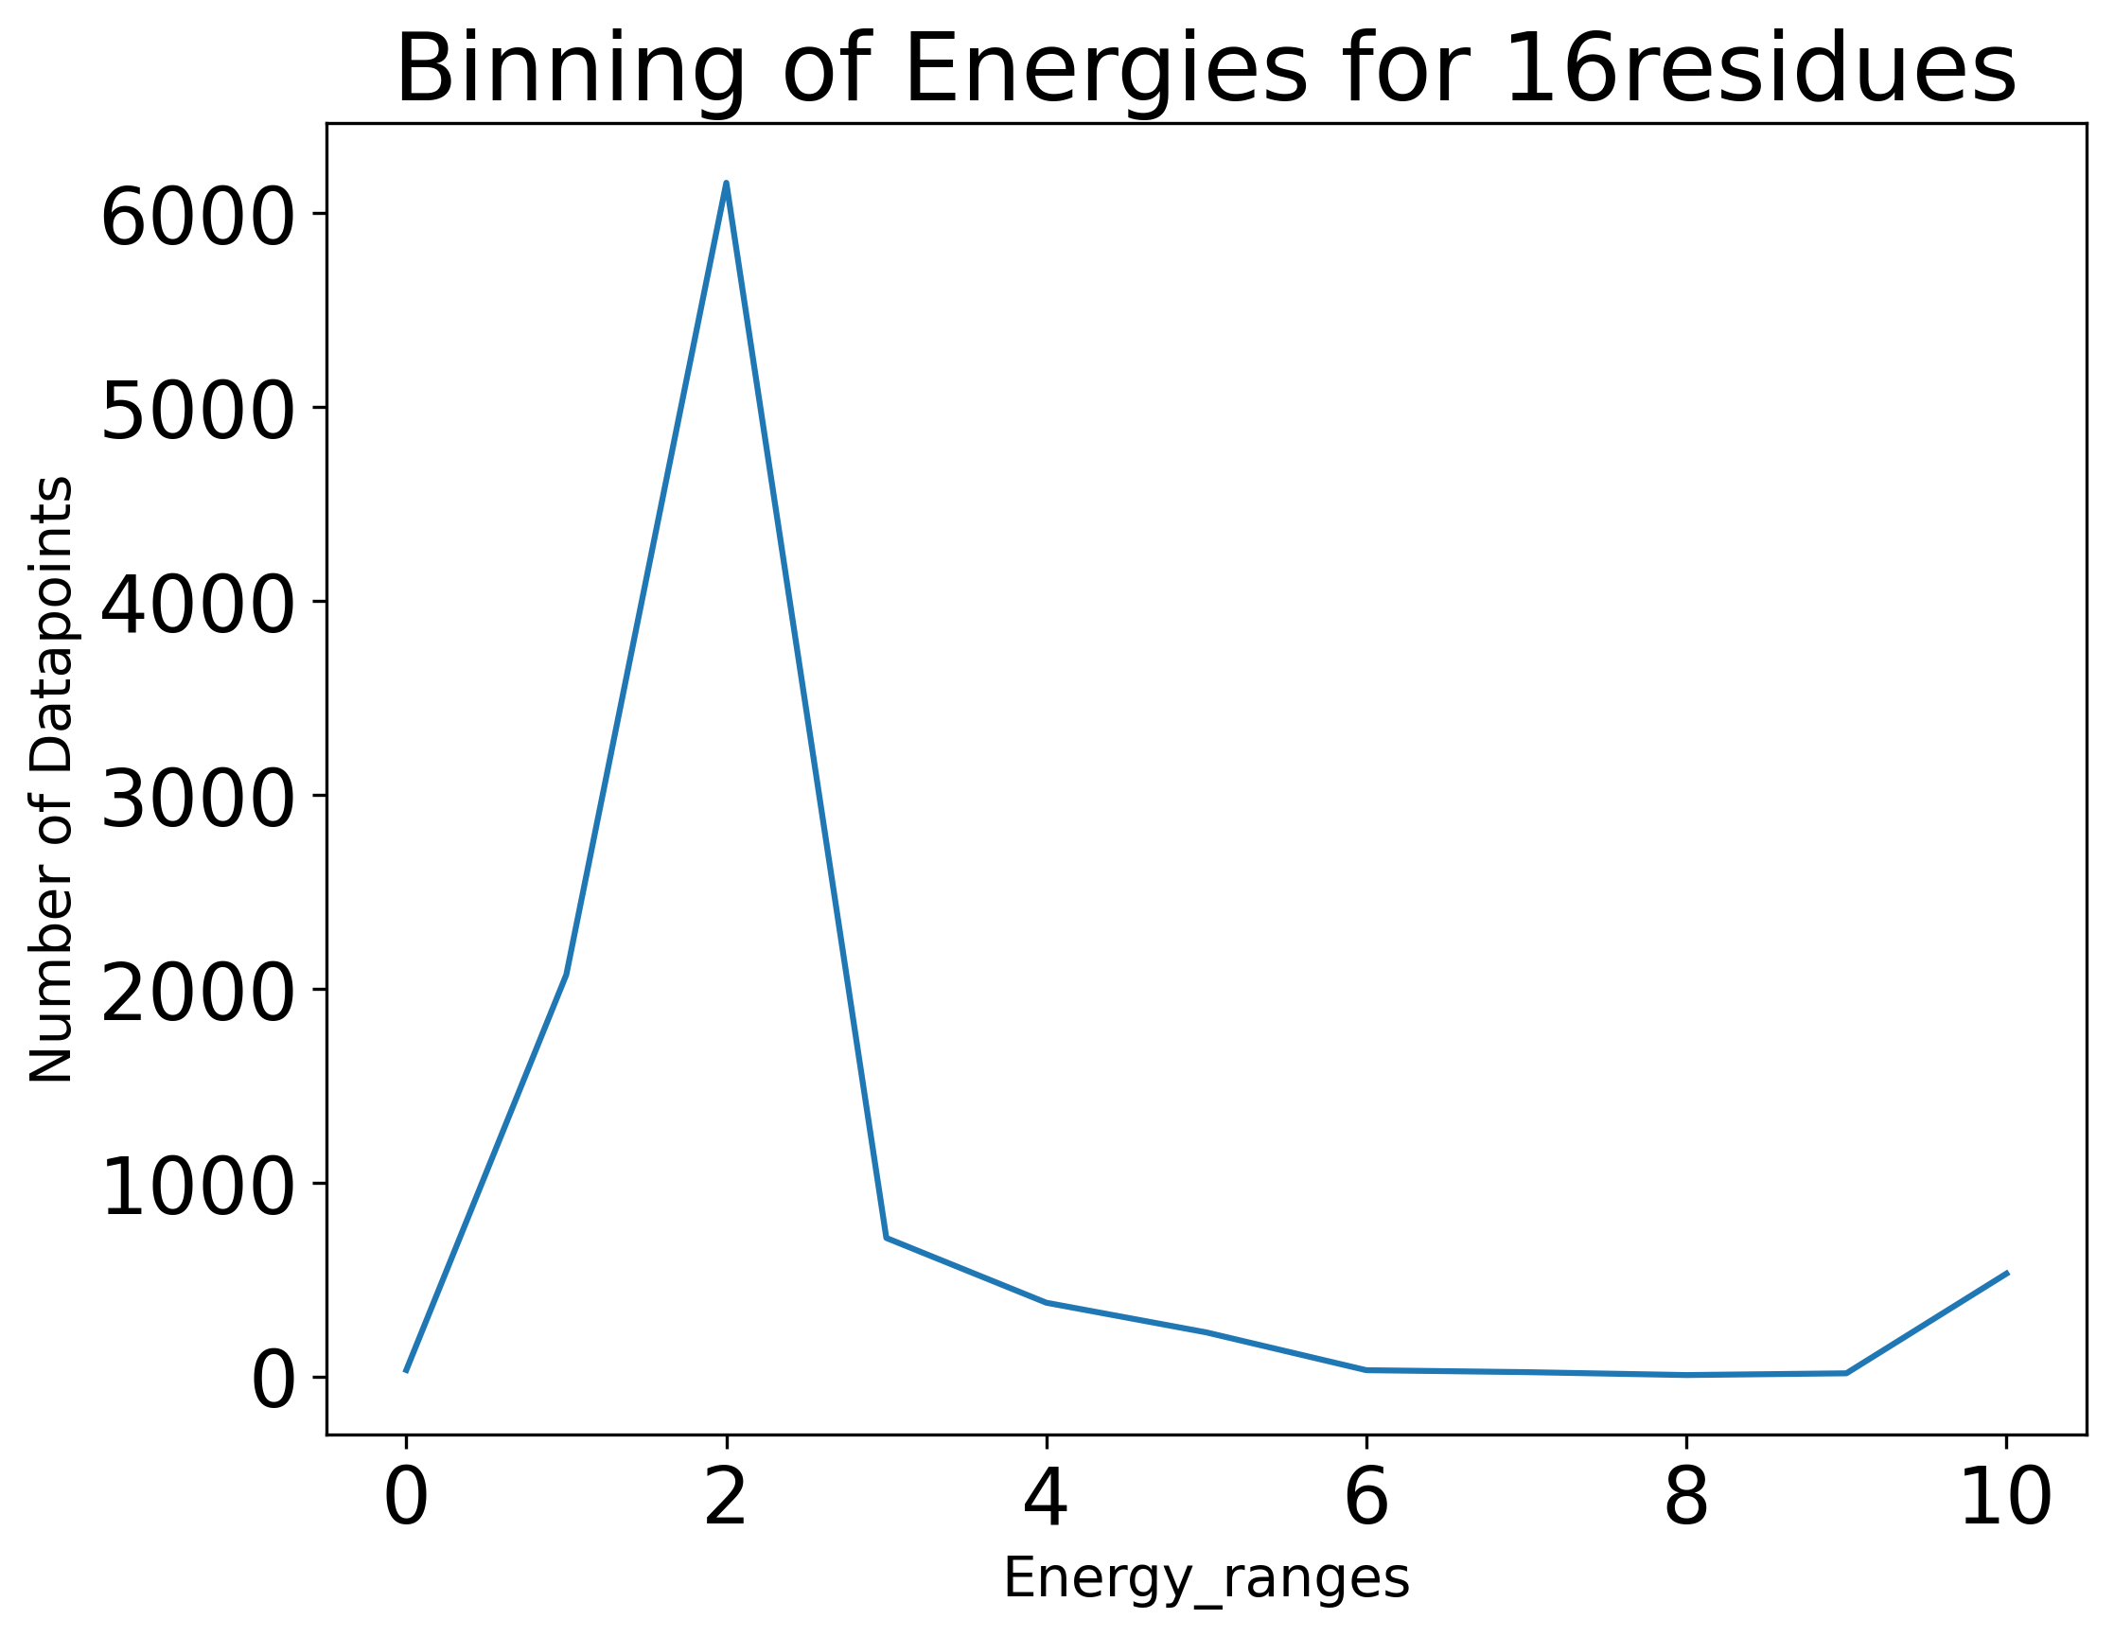
Can we predict and classify the protein energy based on protein sequence?
Create Artificial Targets (11)
10 = (master['Energy'] > 0),
9 = (master['Energy'] < 0) & (master['Energy'] >= -25),
8 = (master['Energy'] < -25) & (master['Energy'] >= -50),
7 = (master['Energy'] < -50) & (master['Energy'] >= -100),
6 = (master['Energy'] < -100) & (master['Energy'] >= -200),
5 = (master['Energy'] < -200) & (master['Energy'] >= -500),
4 = (master['Energy'] < -500) & (master['Energy'] >= -750),
3 = (master['Energy'] < -750) & (master['Energy'] >= -1000),
2 = (master['Energy'] < -1000) & (master['Energy'] >= -1500),
1 = (master['Energy'] < -1500) & (master['Energy'] >= -1750),
0 = (master['Energy'] < -1750) & (master['Energy'] >= -2000)
175 Residue Sequence
SFEEAIQEAQQTGQKAQQAGQEFAQAGQAAQQTGQKVQQAGGSGGFQQGFQEHRQAGQAIQQTFQEDQQAFQEHRQAGQKFQKYGGGSGGSLEKAIQEAQQTVQEVQQAIQEERQAFQAVQQTAQEFQQAGGSGGAQQAVQKARQAGQAGQQTAQKAQQAVQKHRQAFQEVQKYG
Now we apply some
ML Techniques we learned!

Slide 7
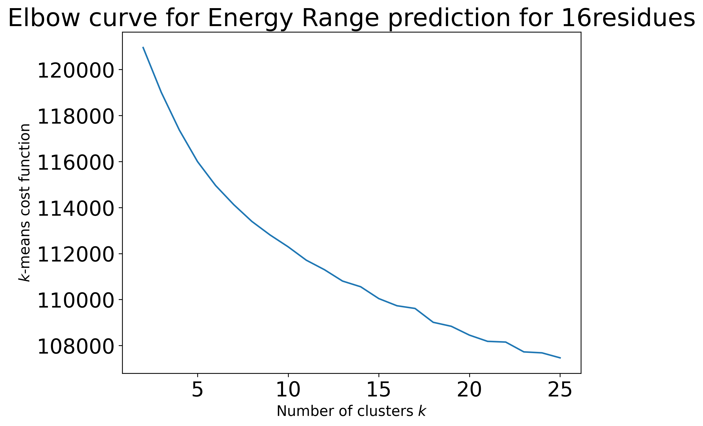
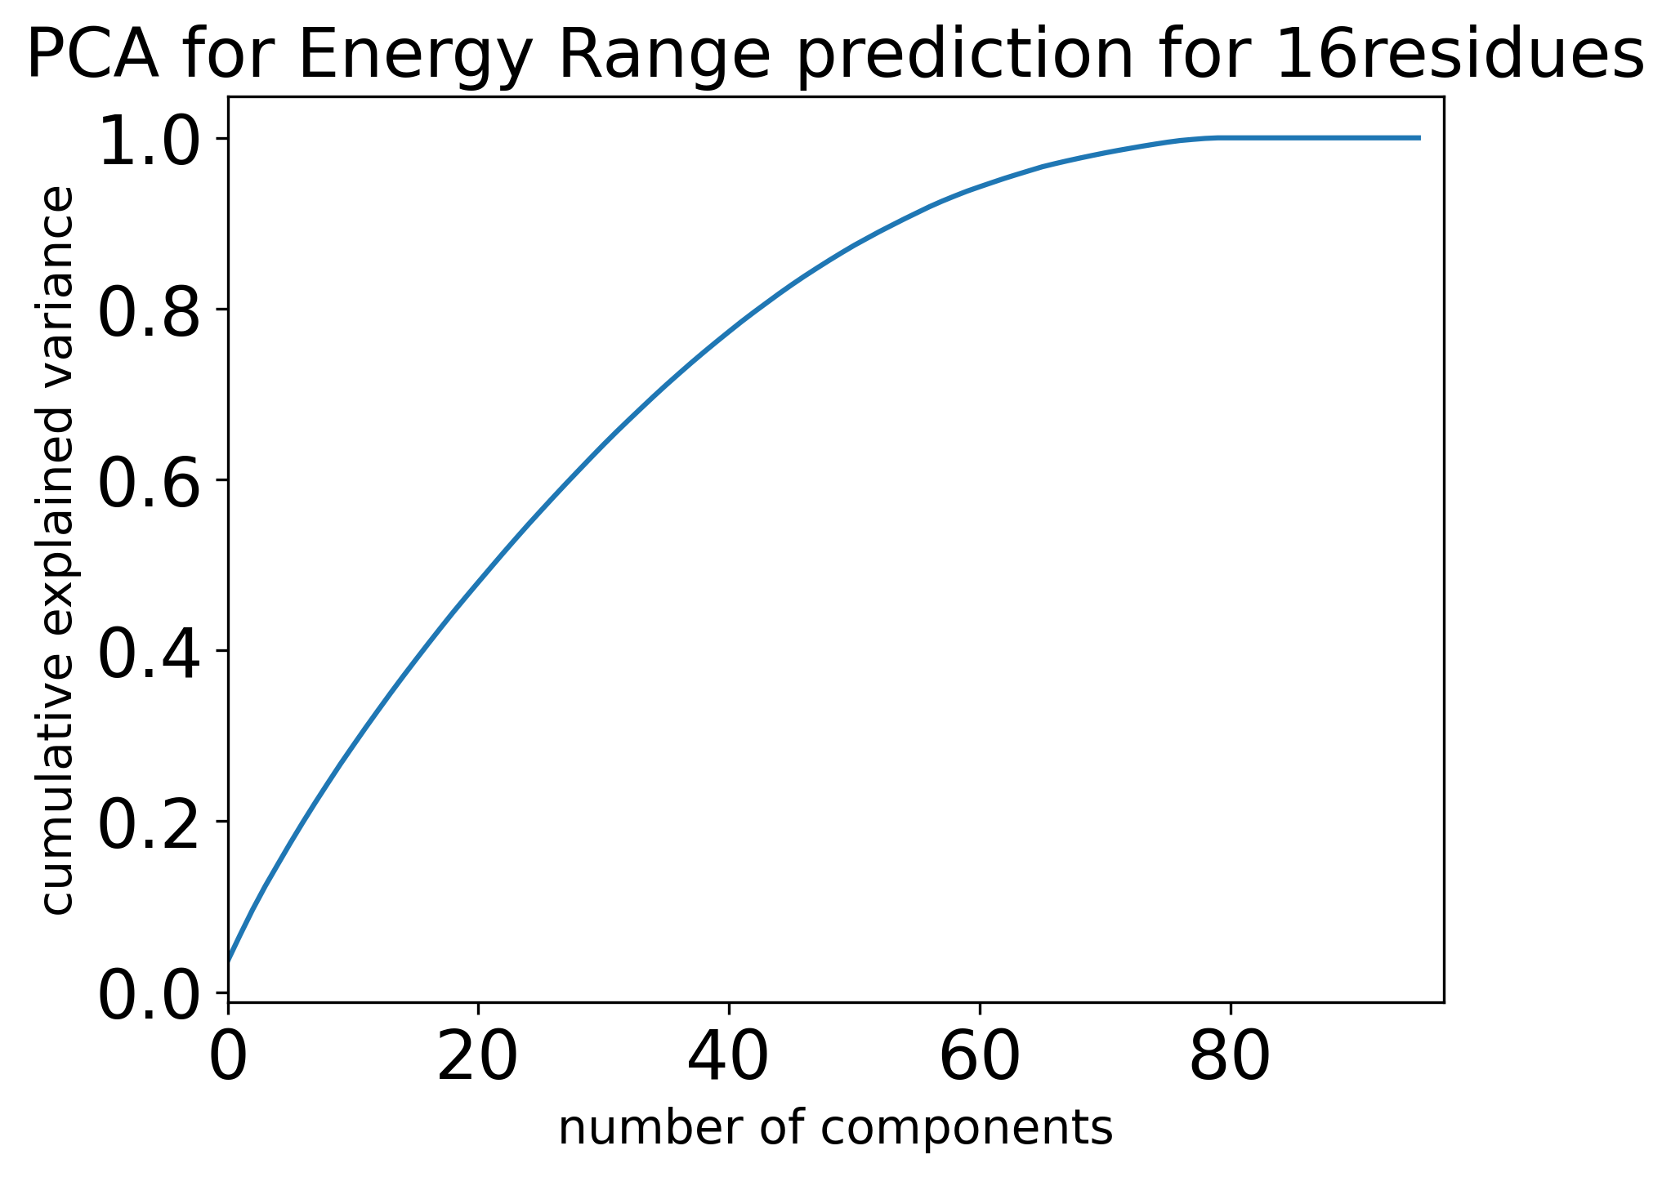
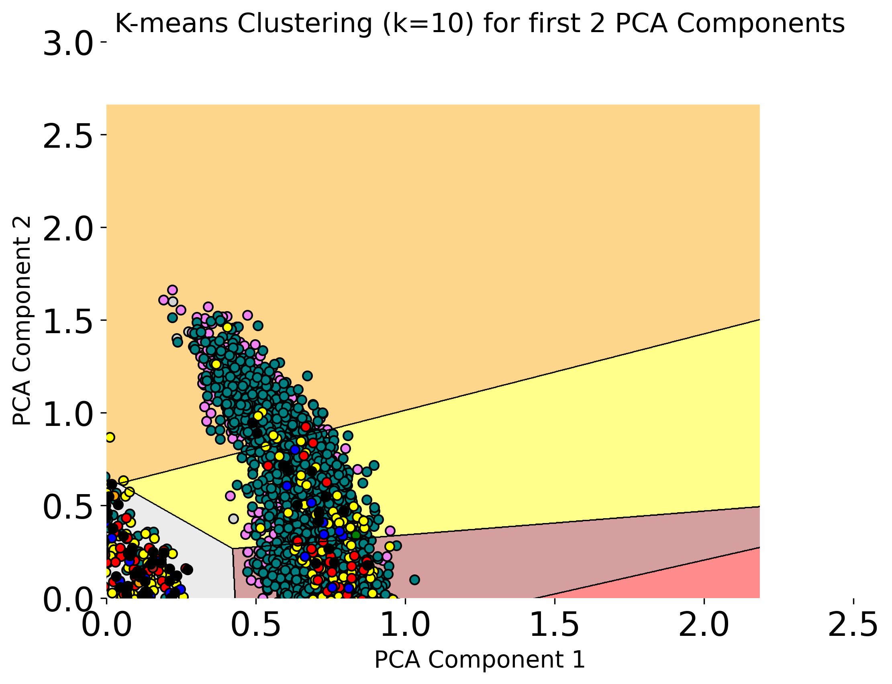
K-means clustering & PCA
K-means clustering elbow curve is debatable,
clusters are not easily found
80 PCA components are a safe bet to use

Slide 8
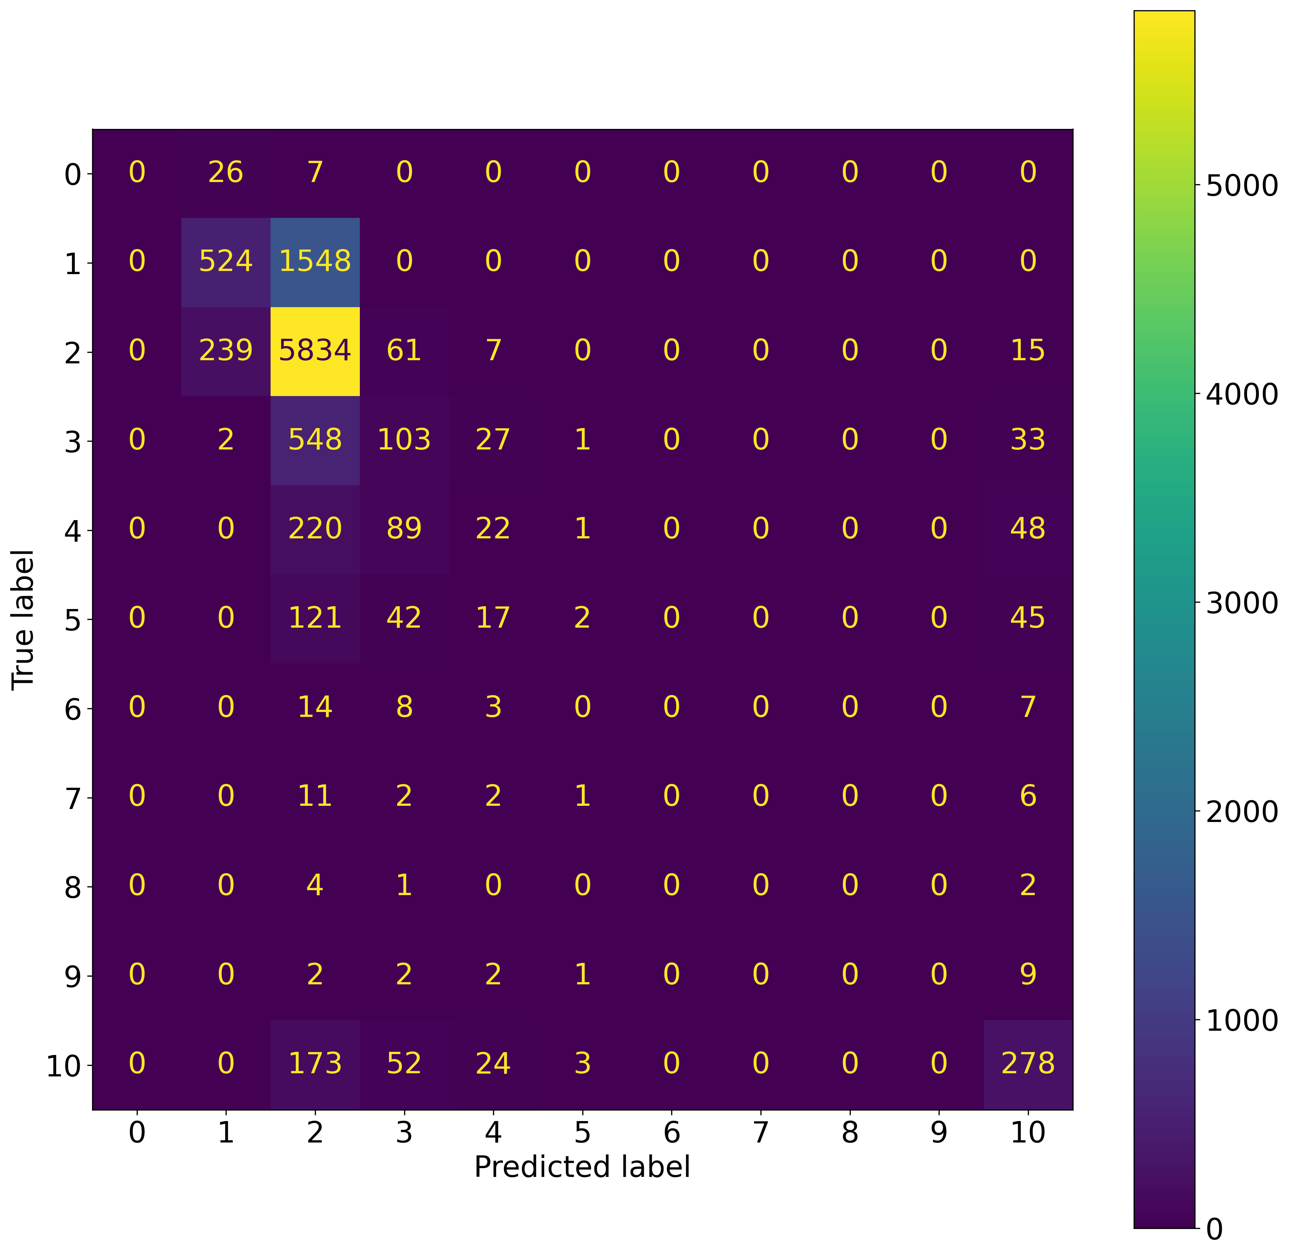
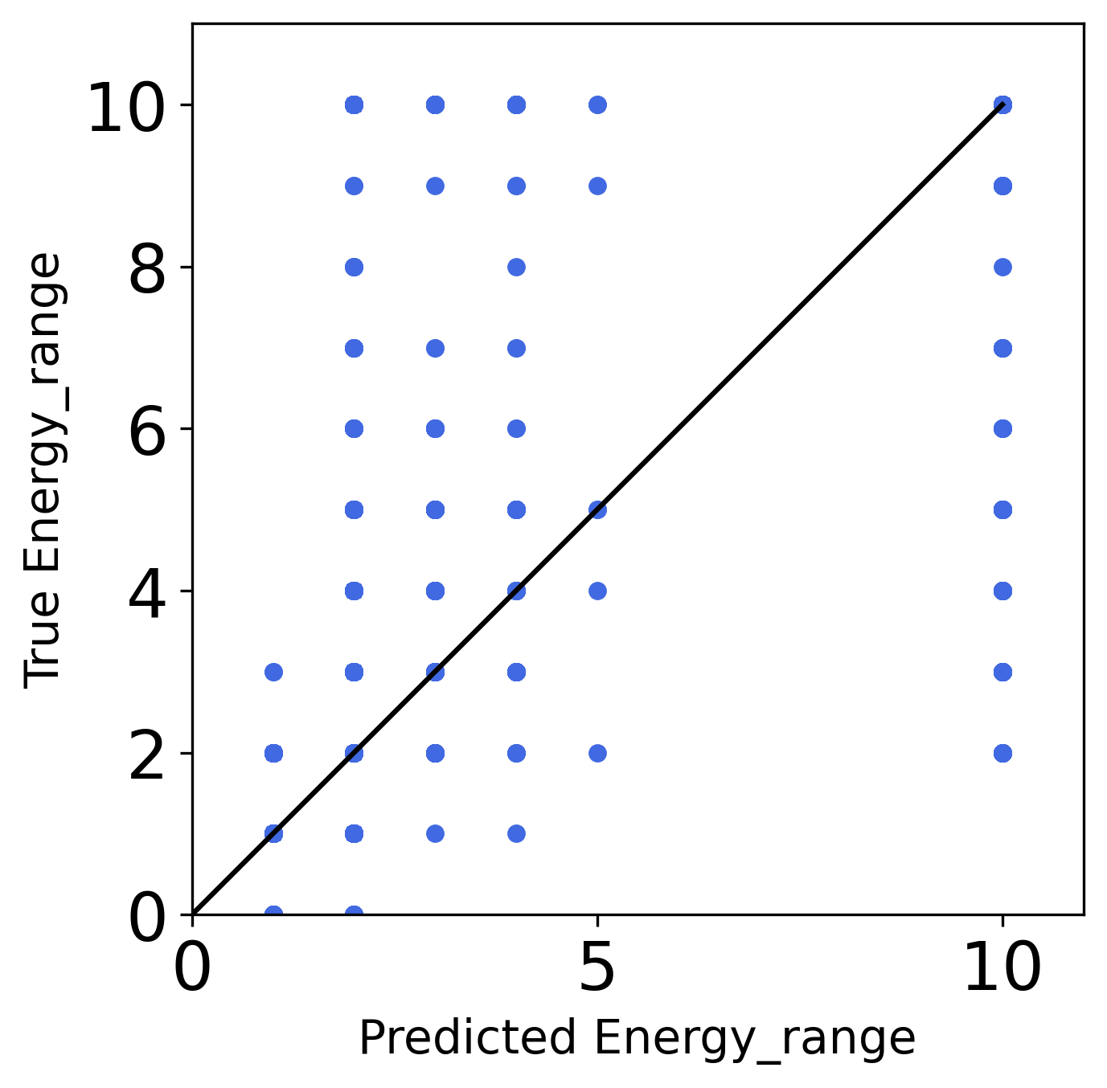
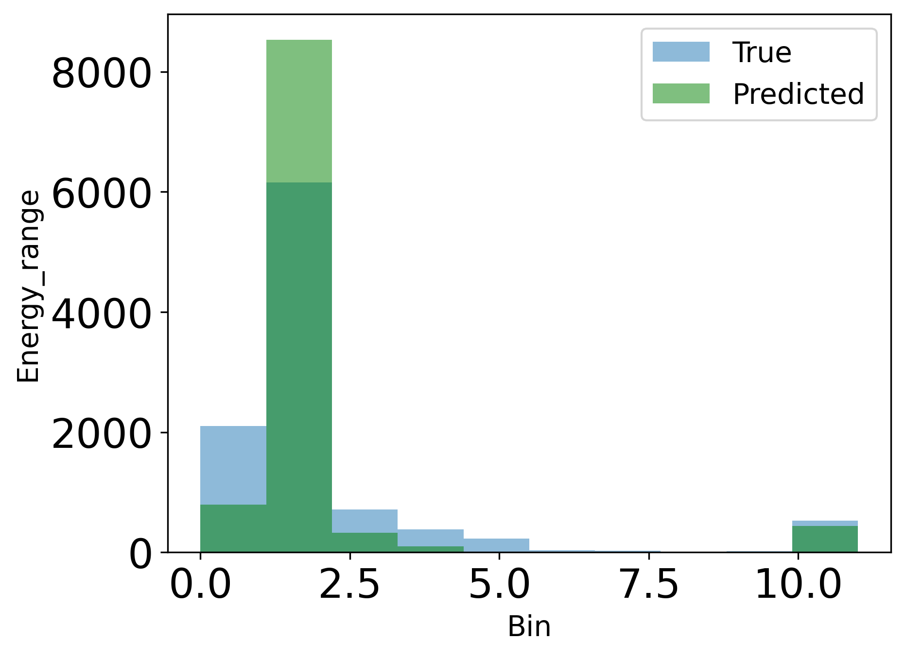
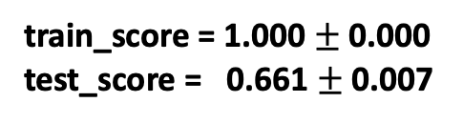
Random Forest with 80 PCA Components
Energy_Range targets predicted with 0% accuracy
→They also have the fewest datapoints
train_score = 1.000$±$0.000
test_score = 0.661 $±$0.007
Targets with many datapoints were
better categorized by model

Slide 9
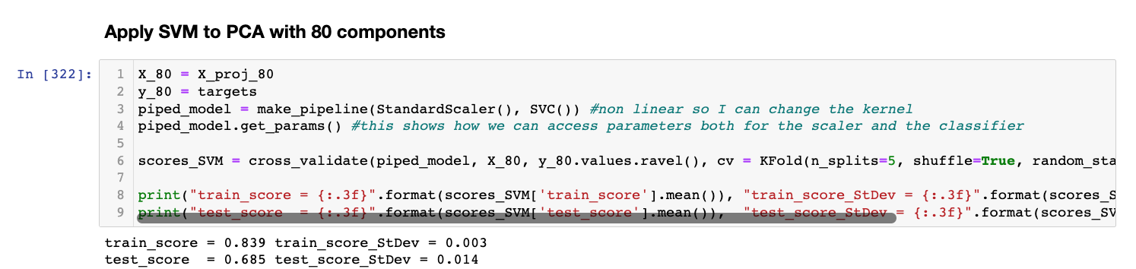
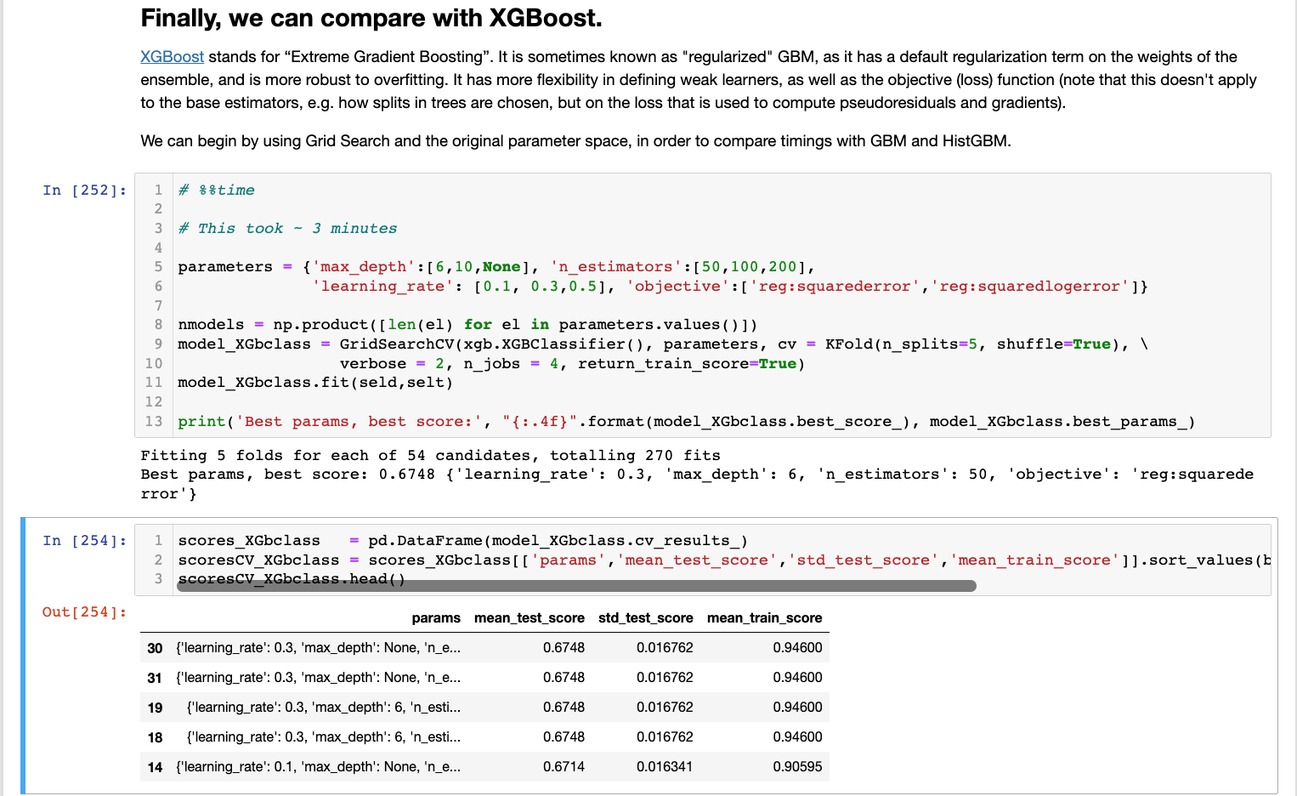
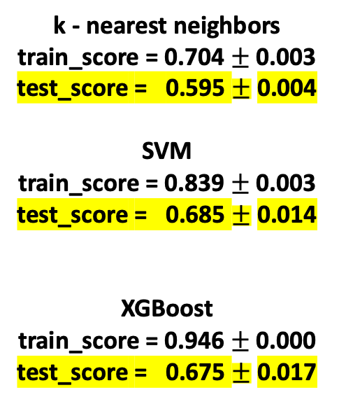
SVM and XGBoost with 80 PCA Components
k - nearest neighbors
train_score = 0.704 $±$0.003
test_score = 0.595 $±$0.004
SVM
train_score = 0.839$±$0.003
test_score = 0.685 $±$0.014
XGBoost
train_score = 0.946$±$0.000
test_score = 0.675 $±$0.017
Both models had high variance but SVMs seemed to work better in reducing it

Slide 10
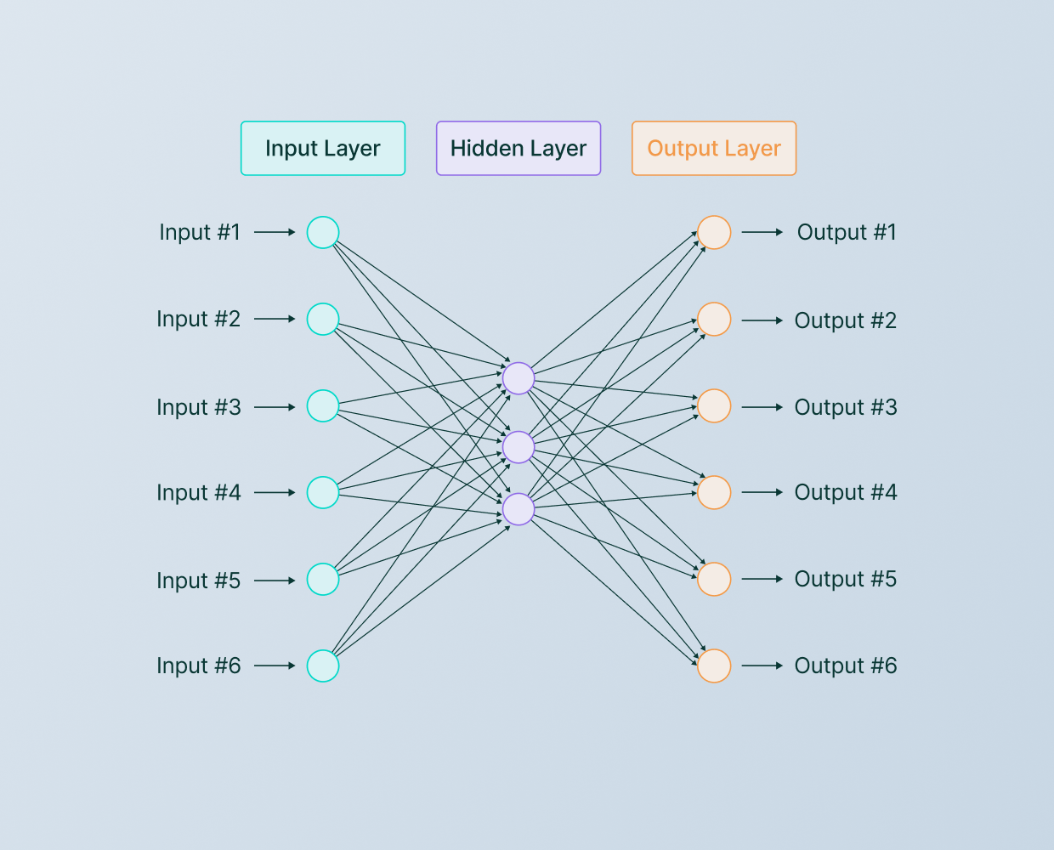
Future Directions – Apply Deep Learning
Use same approach for Kaggle Project

